Slide 1


Blockchain Anonymization -- The Fight for Privacy
LING Zong, Ph. D.
Senior Software Engineer / Scientist
IBM Almaden Research Center
San Jose, California, U.S.A.
Notes:
The Fight for Privacy: Anonymization Techniques, Protocols, and Altcoins
There is much hype around Blockchain.
Most of this relates to the use of Blockchain to underpin the Bitcoin crypto currency.
Whilst IBM are not interested in Crypto currency, we are very interested in exploring the broader business application of Blockchain technology. This is a transformational opportunity for many of our clients
This touches most all industries – we are making Blockchain REAL for business.

Slide 2
Lecture Outline
Anonymity Basics
Deanonymization techniques
Anonymity through Mixing
Centralized Mixers
Altcoin Exchange Mixing
Decentralized Mixing
Privacy-focused Altcoins
Conclusion

Slide 3
Anonymity Basics

Slide 4
Blockchains are not anonymous by default
Intuition: Blockchains take a central database and distribute it
However, this means that you now have no access control
All of the data is public by default
Private blockchains are slightly more anonymous since only a few members have access to the database
Most blockchains are pseudonymous - we use an identity that is not our real identity (e.g. your Bitcoin address)
Our pseudonyms may or may not be "linked" to our real identity

Slide 5
Deanonymization
"Linking" in the context of anonymity is associating a real world identity to a pseudonym. This is also called deanonymization
In Bitcoin: an identity and an address
In Ethereum: an identity and an account
Bitcoin best practice achieves a small degree of anonymity
Best practice: Never reuse your pseudonyms!
Generate a new address every time you receive Bitcoin
Like creating a new reddit account for every single comment
Not possible in Ethereum, since it is account-based (not UTXO based)
But basic analysis renders this technique ineffective

Slide 6
Degree of anonymity
Anonymity isn't absolute (not a clear yes or no)
The "degree of anonymity" (or sometimes "level of anonymity") is defined by how difficult it is to associate your pseudonym with your real world identity.
A high degree of anonymity allows you to reasonably expect having achieved privacy. But why is this important?

Slide 7
"Anonymity is only for buying drugs, right?"
Imagine these scenarios in a blockchain-based financial world.
'Bob's Burgers'
You make a purchase at Walgreens. Your cashier looks you up on blockchain.info and sees 20 purchases a month to the address publically labeled "Bob's Burgers," but everyone knows that that's the hidden name for the internet's biggest pr0n site.
Extreme example - blackmail: The same store employee also sees that you're sitting on a stash of $60 million in Bitcoin. When they kidnap your mother next week, they know exactly how much money to blackmail you for.
Notes:
stash n. 隐（贮）藏物; （旧） 藏身处;

Slide 8
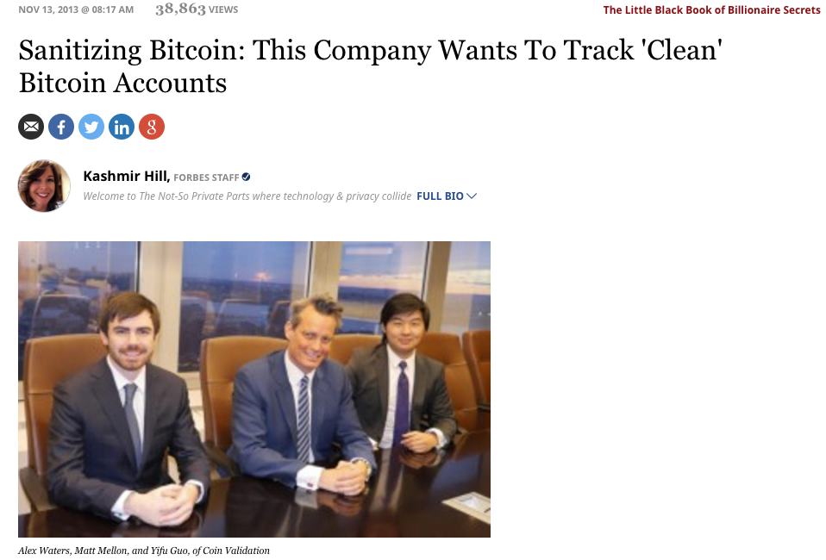
"Anonymity is only for buying drugs, right?"
Example: Getting paid back by a friend
A restaurant refuses to split the bill, and you volunteer to foot it. Your friend send you some Bitcoin. Later, you go to Bob's Burgers to make a purchase with your friends' Bitcoin, but they don't accept your payment because "your money is associated with drug dealers."
Fungibility is the idea that every unit of a currency must be equal in value to every other unit
Crucial property of currency
Source: Forbes on "Coin Validation“
http://www.forbes.com/sites/kashmirhill/2013/11/13/sanitizing-bitcoin-coin-validation/#6bb370ed6a45
Notes:
fungibility n. 可替代性;

Slide 9
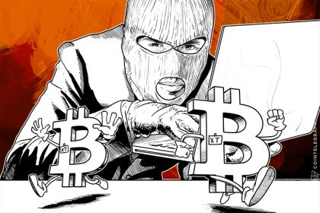
"Anonymity is only for buying drugs, right?"
Example: Businesses on the blockchain
You've just founded a hot new startup run purely on the blockchain - BitBlockBaseCoinPay.cash. You want to keep up to date with your competitor CoinBitBlock.pay so you purchase their product. Except now they know all of your operational expenses, how much revenue you have, who your customers are, and your secret business strategy.
Conclusion:
A lack of anonymity means everyone you've ever transacted with gets to see how you've spent your money in the past and forever into the future.
Source: CoinTelegraph

Slide 10
Anonymity and Ethics
Anonymous cryptocurrencies can indeed be used for money laundering and online drug purchases.
Partial solution: the interfaces between cryptocurrencies and fiat currencies are highly regulated
Recall AML/KYC : can trade cryptocurrencies almost anonymously but can't touch USD/GBP/EUR without a picture of your passport
Hard to implement "morality" at a technological level
Moral and immoral use cases look identical from a technological standpoint
Do the positive benefits to society outweigh the costs?
Example: Tor (https://en.wikipedia.org/wiki/Tor_(anonymity_network) )
Created by the U.S. government.
Tor directs Internet traffic through a free, worldwide, volunteer overlay network consisting of more than seven thousand relays to conceal a user's location and usage from anyone conducting network surveillance or traffic analysis.
Makes it difficult for the officials to monitor web traffic, but they've found other ways
Enables free speech for reporters in oppressive regimes
Notes:
Tor is free and open-source software for enabling anonymous communication. The name derived from the acronym for the original software project name "The Onion Router". Tor directs Internet traffic through a free, worldwide, volunteer overlay network consisting of more than seven thousand relays to conceal a user's location and usage from anyone conducting network surveillance or traffic analysis. Using Tor makes it more difficult to trace Internet activity to the user: this includes "visits to Web sites, online posts, instant messages, and other communication forms". Tor's intended use is to protect the personal privacy of its users, as well as their freedom and ability to conduct confidential communication by keeping their Internet activities unmonitored.

Slide 11
Deanonymization Techniques

Slide 12
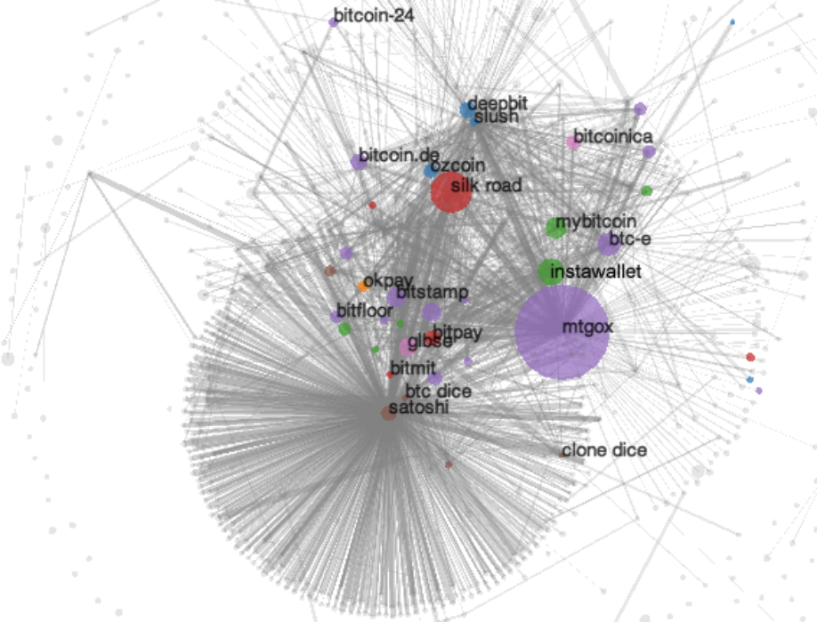
Deanonymization via Transaction Graph Analysis
Transaction Graph Analysis: Analyzing the graphs of transactions in the blockchain
Goal of deanonymization: Link an entity's real world identity with their pseudonym(s)
Clustering: Attributing a cluster of addresses to the same entity
Bitcoin's transaction graph in 2013.
A Fistful of Bitcoins: Characterizing Payments Among Men with No Names (Meiklejohn et al)

Slide 13
Clustering
Case 1: Buying coffee of cost 0.05 BTC with 0.02 BTC and 0.03 BTC UTXOs. A and A' merging into one output links them together.
(Bob's previous outputs)
Two main heuristics to associate two addresses:
Merging of transaction outputs
Occurs when there are multiple inputs to a transaction
Fairly reasonable assumption that the two input addresses are paired by the same entity
Rarely do people conduct joint payments
Change addresses
Transaction is split into 0.95 and 0.05 amounts
One of them must be a change address unless two items were purchased jointly
Helpful heuristic: Change addresses are usually newly generated - never before seen on the blockchain
In both cases, if address A was known to be owned by Bob, we now know that address A' is also owned by Bob.
A: .02 BTC
C: 0.05 BTC
A': .03 BTC
Case 2: Buying coffee of cost 0.05 BTC with a 1 BTC UTXO. Identifying the change address links addresses A and A' together.
(to coffee shop)
(Bob's original BTC at address A)
C: .05 BTC
A: 1 BTC
A': .95 BTC
(back to Bob)

Slide 14
Identifying services
Several techniques to identify clusters with the real world identities of businesses:
Tagging by transacting
Go to online service (e.g. Coinbase) and make a transaction with them
Wait for address to be merged with rest of the cluster
Infer by looking at activity
In 2013, Mt. Gox was large part of ecosystem
Large volume (large purple dot)
SatoshiDice was a gambling site allowing smaller denominations
Small volume (small dot)
Lot of transactions
Bitcoin's transaction graph in 2013.
A Fistful of Bitcoins: Characterizing Payments Among Men with No Names (Meiklejohn et al)

Slide 15
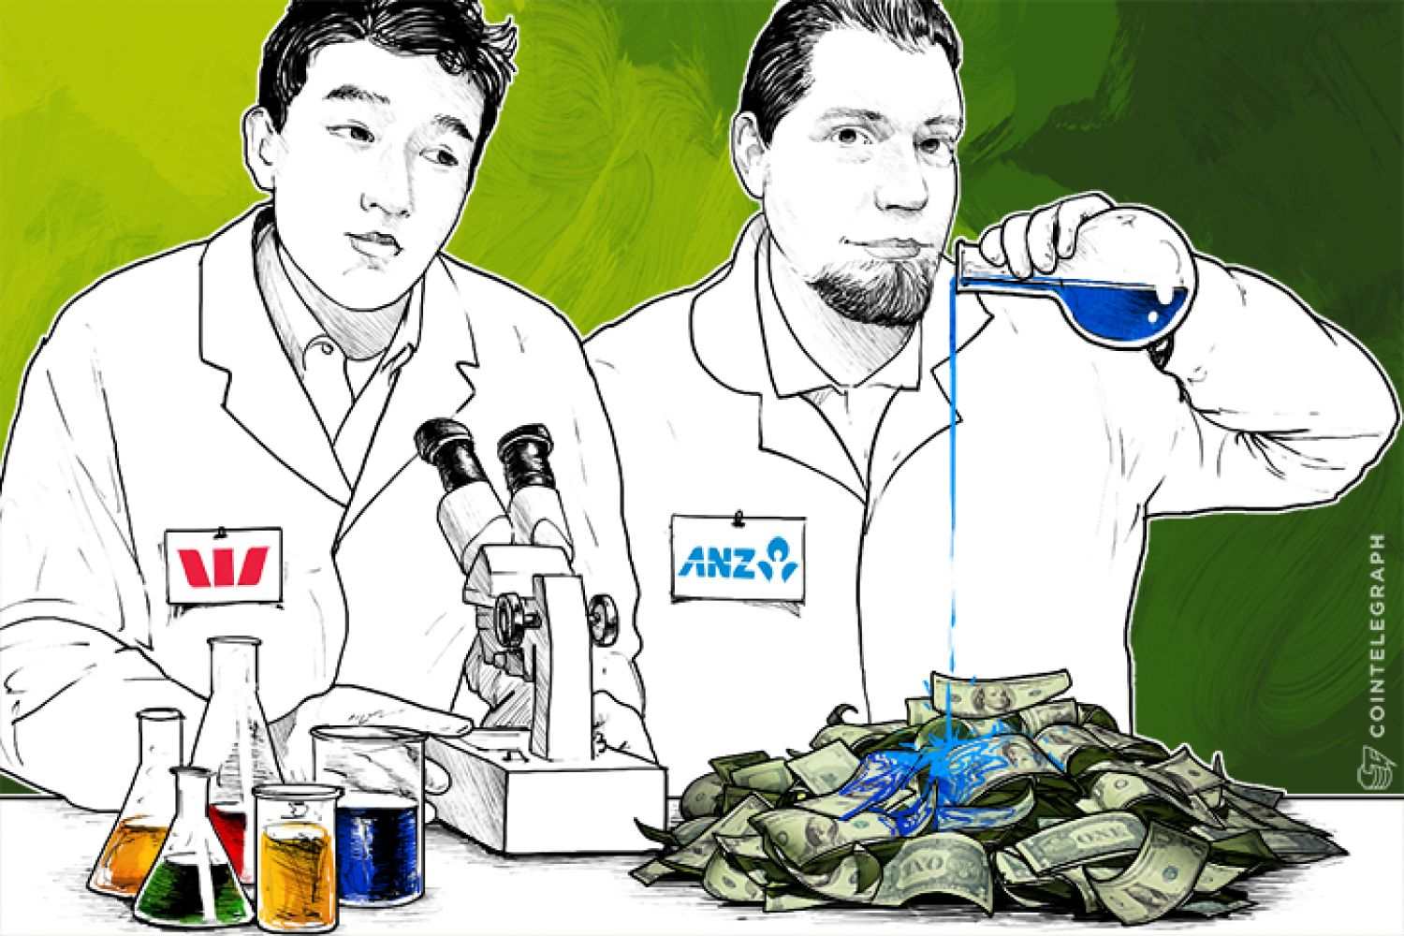

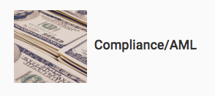
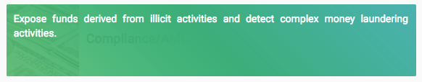
Identifying individuals
who dat?
idk
Several techniques to associate addresses with individuals:
Sending them Bitcoin
Obviously, they need to reveal an address
Carelessness
Posting your Bitcoin address publicly anywhere (like on forums) reveals at least one address
Service providers
Ex. Skry (previously Coinalytics)
Source: CoinTelegraph
Source: skry.tech ("Bloomberg for Bitcoin")

Slide 16
Taint analysis
Each circle is an address.
Let t denote the "taint" at that address.
t = 100%
t = 100%
t = 100%
If no "clean" funds are mixed in, taint remains intact no matter how many intermediate addresses are involved
Origin ("dirty")
1 BTC
1 BTC
1 BTC
t = 100%
Taint is the percentage of funds received by an address that can be traced back to another address
Taint analysis can reveal useful information
See whether money came from a 'tainted' source
Example: tag a known "bad" address
E.g. Silk Road
Taint analysis ruined Ross Ulbricht's defense that his huge Bitcoin stash was obtained legitimately!
Naive anonymization strategy: send all your coins to a bunch of fresh addresses (manual mixing). Taint analysis is why manual mixing doesn't work!
Another origin
("clean")
1 BTC
0.5 BTC
t = (1BTC * 100% + 0.5BTC * 0%) / (1 + 0.5) = 66.6%
t = 0%
1 BTC
1 BTC
1 BTC
t = (1BTC * 66.6% + 1BTC * 0%) / (1 + 1) = 33.3%
t = 0%
"Clean"
origin
1 BTC
2 BTC
t = (1BTC * 33.3% + 2BTC * 0%) / (1 + 2) = 11.11%
t = 0%
Address has less taint the more "clean" funds are mixed in. Spending from this address probably ok
"Dirty"
origin
0.05 BTC
1 BTC
t = (0.05BTC * 11.11% + 1BTC * 100%) / (0.05 + 1) = 95.77%
t = 100%
Large amounts transacted will have a strong effect on the taint

Slide 17
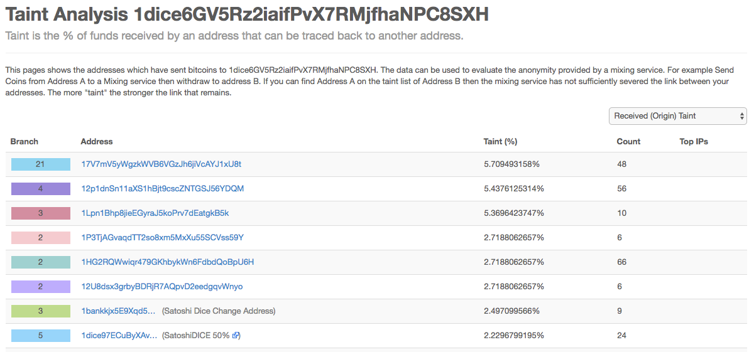
Taint analysis tool on Blockchain.info

Slide 18
Anonymity through Mixing

Slide 19
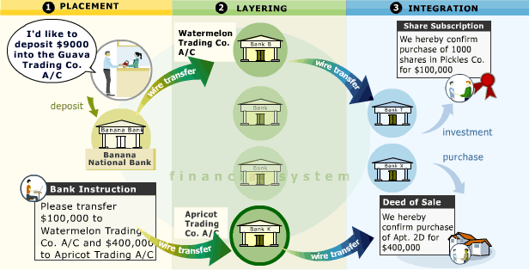
Mixing
Traditional Mixing / Money Laundering:
Create hundreds of fake “shell” companies, which don’t do anything or own any assets, but look like they do (according to the accounting books and tax returns).
Over time, deposit “dirty” funds into shell corps. (Placement).
Shell corps. write off deposits as purchases, investment, etc… to make deposits look real.
Shell corps. further obfuscate by sending funds to other shell corps (Layering).
Finally, criminal org. spends “clean” money on luxury goods, e.g., diamonds, cars, real estate (Integration).
Mixing on blockchains harness the same idea.
Mixing: Making transactions with the intention of concealing the origins of your funds.
Mixing
source: http://casiinoo.blogspot.com/
Notes:
layering n. 分层; obfuscate vt.使模糊，

Slide 20
A Formal Framework for Anonymity
Def.: An anonymity set is the set of pseudonyms between which an entity cannot be distinguished from her counterparts
Main goal of mixing:
We want our anonymity set to be as large as possible
Conducting multiple rounds of mixing exponentially increases our anonymity set
If one round of mixing makes you indistinguishable among N peers, then size of anonymity set is N for one round, N² after two rounds, N³ after three, etc.
However, the size of the anonymity set is bounded by real world constraints
The larger the anonymity set, the harder it is to deanonymize, or "re-link", pseudonyms to identities.
Ideally, it is hard for anyone to link identities to addresses
Additional desirable properties
Trustless (No counterparty risk)
Want to ensure that our funds can‘t be stolen while mixing
Plausibly deniable
It shouldn’t be obvious from transaction history and any other data traces that you’re mixing; i.e. your activity should look just like normal activity
Notes:
plausibly adv. 似真地;

Slide 21
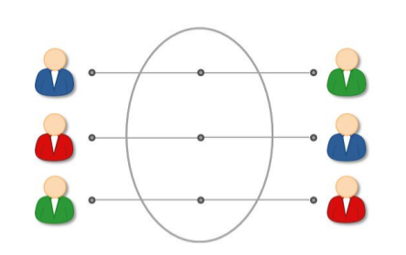
Types of Mixing
Centralized Mixers
Altcoin Exchange Mixing
Decentralized Mixing Protocols
Privacy-focused Altcoins

Slide 22
Centralized Mixers

Slide 23
Centralized Mixers
Send coins to third-party mixer address, mixer sends (hopefully) unlinked coins to you sometime in near future (to minimize timing information leak).
Centralized Mixing Service
Alice’s dirty input
Alice’s cleaned output
A 1 BTC
1.0 BTC
3.0 BTC
A’ 0.9 BTC
0.7 BTC
0.4 BTC
2.0 BTC
0.1 BTC
0.3 BTC
0.6 BTC
M 0.1 BTC
1.0 BTC
1.5 BTC
Mixer sends cleaned funds after random waiting period
Mixer’s “cleaning” fee
Mixing Slush Fund
Notes:
slush n. 烂泥，稀泥浆;

Slide 24
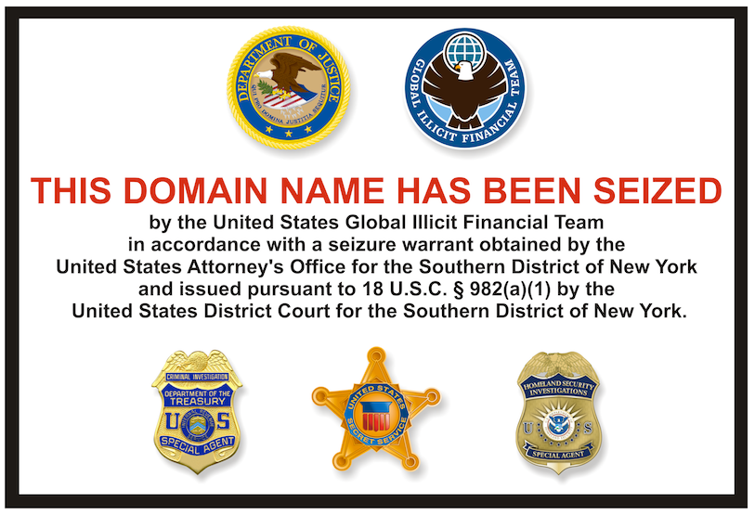
Centralized Mixers - Issues
Counterparty Risk: Mixer could steal funds; have to trust that it won’t.
Logging Risk: Mixer could be logging who it received dirty funds from and where it sent the cleaned funds to.
Centralization Risk: Single point of failure. Single target for hacking. Adversary (e.g. Government) installs its own logging or sends a takedown notice and seizes control of mixer.
Notes:
Adversary n. 对手，敌手; 魔鬼

Slide 25
Altcoin Exchange Mixing

Slide 26
Altcoin Exchange Mixing
Idea: Send dirty funds through several layers of altcoin ⇐⇒ altcoin exchanges to obfuscate money trail.
Exchange
Exchange
Alice’s dirty input
1.0 BTC
10 ETH
1.0 ZEC
0.1 BTC
Alice’s clean output
A 1 BTC
…
0.7 BTC
70 ETH
0.7 ZEC
2.7 BTC
A 0.9 BTC
2.0 BTC
20 ETH
2.0 ZEC
2.0 BTC
0.3 BTC
30 ETH
0.3 ZEC
3.0 BTC
1.0 BTC
10 ETH
1.0 ZEC
0.9 BTC
Exchange Fees

Slide 27
Altcoin Exchange Mixing - Issues
Pros:
Adversary would have to trace transaction chain through several disparate blockchains and exchanges.
Better plausible deniability -- looks like normal currency exchanging.
Cons:
Rely on exchanges keeping transaction mappings hidden
Counterparty risk: Exchange gets hacked ⇒ Lose money in transit
(U.S.) Exchanges usually require personally identifiable information and follow KYC/AML.
Notes:
KYC规则是指了解客户(know-your-customer, KYC)规则。金融机构如不能清晰识别客户身份，便更不愿贷款给客户，阻碍金融普惠，是国际社会努力实现金融诚信和金融普惠不可或缺的。
https://baike.baidu.com/item/KYC%E8%A7%84%E5%88%99/22415276?fr=aladdin

Slide 28
Decentralized Mixing

Slide 29
Decentralized Mixing Protocols
Idea: Remove counterparty risk and avoid fees by taking out the middleman (centralized mixer).
Proposition: Create a network of peers outside of Bitcoin network who cooperate to make transactions which mix their coins, without relying on a trusted third party.
Can this be done?

Slide 30
Dmix Research Project
Well, this is the question is sought to answer.
Dmix Project: Build a trustless, decentralized Bitcoin mixer that maintains plausible deniability.
Additional requirements:
Low fees
Mixing shouldn't be cost-prohibitive; would be impractical
Bitcoin-compatible
Sure, you can mix with a variety of altcoins. But what if you don't want to go through the hassle of exchange? No one has yet developed a Bitcoin mixer with these properties.
Not to mention Lightning Network doesn't exist yet
So let's build Dmix!

Slide 31
Decentralized Mixing Protocols - Nuances
Additional considerations for designing a good decentralized mixing protocol
A mix is comprised of inputs and outputs:
One input and one output are owned by the same entity, and the goal of the mix is to hide the mapping from all inputs to all outputs.
Def. Correctness: Coins must not be lost, stolen, or double-spent. The mixing is truly random and must eventually succeed in mixing or returning the funds of honest users (resilient against DoS attacks).
Adversarial models:
Passive adversary
Not a part of the mix
Basic anonymity prevents passive adversaries from learning the mapping
Semi-honest adversary
Part of the mix
Correctly follows the protocol but attempts to deanonymize the mix by analyzing the procedures of the mix.
Malicious adversary
Part of the mix
Not bound by the protocol specifications; may actively deviate from the protocol and attempt to steal funds
May send false messages, abstain communications, etc.
Notes:
nuances 细微差别; 细微差异; 细微的差别; 微妙; abstain v.(投票时) 弃权; 戒; 戒除; 离开; 回避;

Slide 32
Decentralized Mixing Protocols - Nuances
Sybil resistance in the context of decentralized mixing has a two part definition:
Resistance to stealing funds
Can't rely on 'partial' threshold cryptography to enforce correctness (e.g. m-of-n multisig such that m < n).
Protocol must execute correctly (no funds are stolen) even if all other peers are malicious adversaries
Resistance to deanonymization
Weak: Participants outside the mix cannot determine the mapping of inputs to outputs, but participants within the mix can.
Only requires one semi-honest adversary to break anonymity
Strong: Even participants within the mix do not know the mapping of inputs to outputs
However, a high proportion of Sybil peers reduces the anonymity set.
Notes:
Sybil Attack可译作女巫攻击。即在对等网络中，单一节点具有多个身份标识，通过控制系统的大部分节点来削弱冗余备份的作用。https://baike.baidu.com/item/Sybil%20Attack/7567996?fr=aladdin

Slide 33
Protocol - CoinSwap (2013)
Idea: Natural extension of centralized mixer: “A mixer that can’t run with your coins.”
Using hash-locked, 2-of-2 multi-signature transactions, we can trustlessly send coins through a third-party mixer and the mixer can’t steal the funds.
Pros:
No counterparty risk; mixer can’t steal funds.
Better plausible deniability; passive adversary only sees 2of2 multi-signature transactions
Cons:
Values not hidden; mixer still sees amounts transferred
Mappings not hidden; mixer knows who receives which coins
Expensive; uses 4 transactions per mix round
CoinSwap: https://bitcointalk.org/index.php?topic=321228.0
Notes:
https://en.bitcoinwiki.org/wiki/Coin_Swap

Slide 34
Protocol - TumbleBit (2016)
Idea: Improve on CoinSwap so the mixer can’t steal funds and never learns who receives the clean funds.
Requires a total of 2 transactions on blockchain.
Anonymous vouchers can’t be distinguished from one another and also can’t be forged.
Enables Alice to deposit her dirty coins and receive clean, unlinked coins without revealing herself.
Not restricted to just single mixer. Can be used as primitive in more complex protocols
Recipient does not have to be depositor.
Mixer
Alice deposits dirty coins
Alice receives clean coins
1.0 BTC
A 1 BTC
A’ 1 BTC
1.0 BTC
1.0 BTC
Alice receives voucher
1.0 BTC
Alice later redeems voucher
1.0 BTC
Anonymous Voucher
Anonymous Voucher
TumbleBit: https://eprint.iacr.org/2016/575.pdf
Notes:
https://cs-people.bu.edu/heilman/tumblebit/
Voucher n.凭证; 收据; 证件; 证人;

Slide 35
Protocol - CoinJoin (2013)
Alternative Approach: Mix together coins in a single n-of-n multisignature transaction.
Pros:
Funds can’t be stolen
No central mixing party who needs enough liquidity for good anonymity.
Cons:
Not plausibly deniable; very easy to spot on the blockchain since n-of-n multisignature transaction where n is usually large.
Not DoS attack resistant; only needs 1 malicious node to start protocol and then halt halfway through to disrupt.
Anonymity set limited to transaction participants.
A 1 BTC
A’ 1 BTC
B 1 BTC
Transaction
4.0 BTC
B’ 1 BTC
C 1 BTC
C’ 1 BTC
D 1 BTC
D’ 1 BTC
CoinJoin: https://bitcointalk.org/index.php?topic=279249.0
Notes:
https://en.bitcoin.it/wiki/CoinJoin

Slide 36
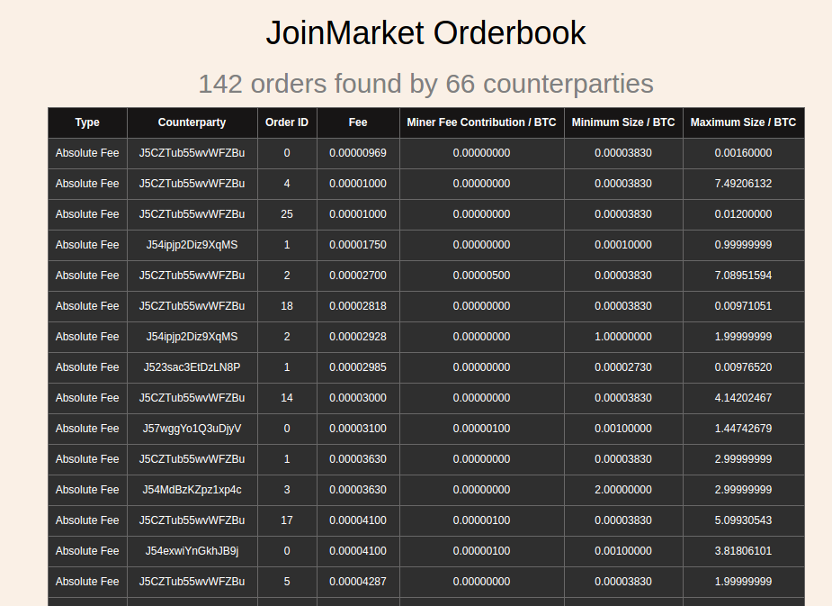
JoinMarket (2015)
Idea: Create market of liquidity providers who are willing to mix their coins for a fee.
Since market makers take almost no risk, mixing fees are typically very small.
Issues:
Mixed coins have small anonymity set
Deanonymizing entire system would require only $32,000 (recoverable after attack) with success rate of ~90% (Möser, Böhme)
JoinMarket: https://github.com/JoinMarket-Org/joinmarket
Möser, Böhme: http://weis2016.econinfosec.org/wp-content/uploads/sites/2/2016/05/WEIS_2016_paper_58.pdf
Notes:
https://github.com/JoinMarket-Org/joinmarket/wiki

Slide 37
Protocol - CoinParty (2015,2016)
I
Input address
Idea: Decentralized mixing protocol but with better deniability. Want transactions to look the same as normal Bitcoin transactions to passive observers.
CoinParty lets us do this, but sacrifices some protocol security.
E
Escrow address
0
Output address
Peers generate escrow addresses. Escrow addresses require ⅔ consensus to spend.
Peers perform secure multi-party shuffle on output address ordering.
If protocol executed correctly, peers agree to transfer funds out of escrow addresses to designated outputs.
I₁
E₁
0₁
0₂
0₃
E₁
0₃
I₂
E₂
0₂
0₁
0₁
E₂
0₁
I₃
E₃
0₃
0₃
0₂
E₃
0₂
1
2
3
COMMITMENT
SHUFFLE
TRANSACTION
Notes:
https://www.researchgate.net/publication/271445761_CoinParty_Secure_Multi-Party_Mixing_of_Bitcoins

Slide 38
Protocol - CoinParty (2015,2016)
Pros:
High plausible deniability; transactions on the blockchain look just like “normal” Bitcoin transactions.
Decent efficiency; requires 2 transactions on the blockchain per input peers.
Cons:
Reduced protocol security; escrow funds controlled by ⅔ threshold signature scheme.
Vulnerable to Sybil Attack; malicious peer can spawn several fake peers, join mix group, overthrow ⅔ threshold, and steal mix group’s funds.

Slide 39
Dmix "Swinger Protocol" & Project Conclusion
The last iteration of Dmix project: Swinger Protocol
Form pairs with your mixing group, designate one as the "husband" and the other as the "wife"
Execute a decryption mixnet pairwise to obliviously obtain a designated pair that your pair shall swap with.
Your "wife" is sent over to the designated husband. They perform CoinSwap to trustless exchange coins
You were the designated pair for another pair; you receive an incoming wife from that pair. Your husband performs CoinSwap with the incoming wife.
Abort protocol if no wife or more than one wife were received.
Nothing that currently exists meets the design goals set out for the Dmix project
Swinger Protocol comes close, but has a lesser degree of anonymity than the naive mixing strategy of simply executing CoinSwap with random nodes on the Dmix network
Forming mixing groups actually reduces the anonymity set since Sybils
Conclusion: Building a good decentralized Bitcoin mixer is damn hard.

Slide 40
Privacy-focused Altcoins

Slide 41

CoinJoin ⇒ DASH
DASH (formerly DarkCoin) is a privacy-centric cryptocurrency that employs a network of Masternodes to perform privileged actions such as voting on proposals, instantly confirm transactions, and mix the coins (by default) of all network participants.
Pros:
Uses CoinJoin for mixing: trustless
No issue of plausible deniability with using CoinJoin since almost everyone on the entire network is participating in CoinJoin transactions
Cons:
Masternode network itself must be secured - can pay 1000 DASH per masternode to hypothetically acquire a large number of them
Dash is an open source cryptocurrency and is a form of decentralized autonomous organization (DAO) run by a subset of users, called "masternodes". It is an altcoin that was forked from the Bitcoin protocol. The currency permits fast transactions that can be untraceable. 45% of mined coins go to miners, 45% to masternodes, and 10% into a fund that the DAO invests.
Notes:
https://en.wikipedia.org/wiki/Dash_(cryptocurrency)

Slide 42
CryptoNote ⇒ Monero
Idea: Hide input/output mappings with Ring Signatures. Choose some set of previous outputs to “mix” with. These are then bound with your outputs in a cryptographic ring signature.
Ring Signature: In this context, prove you own one of the outputs without revealing which specific output.
In cryptography, a ring signature is a type of digital signature that can be performed by any member of a group of users that each have keys.
Therefore, a message signed with a ring signature is endorsed by someone in a particular group of people.
One of the security properties of a ring signature is that it should be computationally infeasible to determine which of the group members' keys was used to produce the signature.
Ring signatures are similar to group signatures but differ in two key ways: first, there is no way to revoke the anonymity of an individual signature, and second, any group of users can be used as a group without additional setup. Ring signatures were invented by Ron Rivest, Adi Shamir, and Yael Tauman, and introduced at ASIACRYPT in 2001. The name, ring signature, comes from the ring-like structure of the signature algorithm.
https://en.wikipedia.org/wiki/Ring_signature
Issue: Monero doesn’t hide transaction values (yet). Adversary could potentially trace transactions by following likely value flows. Temporal correlations also pose an issue.
Issue: Decent anonymity set, but can we do better?
Monero (XMR) is an open-source cryptocurrency created in April 2014 that focuses on fungibility, privacy and decentralization. Monero uses an obfuscated public ledger, meaning anybody can broadcast or send transactions, but no outside observer can tell the source, amount or destination. Monero uses a Proof of Work mechanism to issue new coins and incentivize miners to secure the network and validate transactions.
Notes:
https://en.wikipedia.org/wiki/Monero_(cryptocurrency)

Slide 43
zk-SNARKs ⇒ ZCASH
Idea: Altcoin where transactions reveal nothing about input/output addresses AND input/output values.
Using zero-knowledge Succinct Non-interactive ARguments of Knowledge (zk-SNARKs) a.k.a. “Crypto Magic” we can create a system which supports fully anonymous payments.
ZCash Black Box
A 1 ZEC
Mint
Pour
A’ 1 ZEC
Zcash is a cryptocurrency aimed at using cryptography to provide enhanced privacy for its users compared to other cryptocurrencies such as Bitcoin. Like Bitcoin, Zcash has a fixed total supply of 21 million units. Transactions can be "transparent" and similar to bitcoin transactions in which case they are controlled by a t-addr, or can be a type of zero-knowledge proof called zk-SNARKs; the transactions are then said to be "shielded" and are controlled by a z-addr. Zcash coins are either in a transparent pool or a shielded pool; as of December 2017 only around 4% of Zcash coins were in the shielded pool and at that time most wallet programs did not support z-addrs and no web-based wallets supported them.
Zcash affords private transactors the option of "selective disclosure", allowing a user to prove payment for auditing purposes. One such reason is to allow private transactors the choice to comply with anti-money laundering or tax regulations. "Transactions are auditable but disclosure is under the participant's control.“ The company has hosted virtual meetings with law enforcement agencies around the U.S. to explain these fundamentals and has gone on the record of saying that "they did not develop the currency to facilitate illegal activity".
Notes:
https://en.wikipedia.org/wiki/Zcash
Succinct adj.简明的

Slide 44
ZCash
Pros:
Fully Anonymous; Assuming security of underlying crypto, blackbox transactions are anonymous. Anonymity set of entire blackbox history.
Cons:
Resource Intensive; zk-SNARK proof system currently in use requires about 4 GB of RAM and 2 minutes of computation on modern CPU to generate proofs for pour transactions.
Requires Semi-Trusted One-time Setup; adversary with toxic setup parameters can mint coins without spending base coins. Can be somewhat mitigated with a secure multiparty computation setup.

Slide 45
Mixing Caveats
Side channel attacks
Generally, we want to use TOR for everything
However, TOR exit nodes may be adversary-controlled
Analyzing transaction amounts
Easy to identify input and outputs (E.g. 1337.6969 BTC in -> 1337.420 out: hmmmmm 🤔 )
Solution: Always use uniform transaction amounts (like 1 BTC, 0.1 BTC)
All transactions going through all mixes would look the same
For this reason, fees should be all or nothing
Timing correlations
Humans often act in predictable ways
Solution: the client that handles interactions with other peers should be automated
Network-level deanonymization (transaction propagation)
"The first node to inform you of a transaction is probably the source of it."
Notes:
caveats n. 警告，附加说明

Slide 46
Conclusion
Rough comparative level of anonymity: (least anonymous to most anonymous)
Bitcoin
Centralized mixers
Decentralized mixing protocols
CoinSwap
CoinJoin
CoinShuffle
CoinParty
Blindly Signed Contracts
Tumblebit
Altcoin exchange
DASH
Monero
Zcash
Practical question: How would I mix coins today? (In November 2016)
Probably altcoin exchange through DASH/Monero/Zcash + TOR/VPN + throwaway exchange accounts and emails

Slide 47
Lecture Outline
Anonymity Basics
Deanonymization techniques
Anonymity through Mixing
Centralized Mixers
Altcoin Exchange Mixing
Decentralized Mixing
Privacy-focused Altcoins
Conclusion

Slide 48









完
Hindi
Traditional Chinese
Thai
Gracias
Russian
Thank You
Spanish
Obrigado
English
Brazilian Portuguese
Arabic
Danke
Grazie
German
Italian
Simplified Chinese
Merci
French
Tamil
Japanese
Korean
Notes:
48

